Slide 1
Weekly Project Update
Laurent Bialylew
Jalal Mammadov

Slide 2
Work done this week
01
02
03
Created UMLs
Added new UML diagrams
Created new class
Created violation class
Created new functions
Created and edited functions for detecting violations

Slide 3
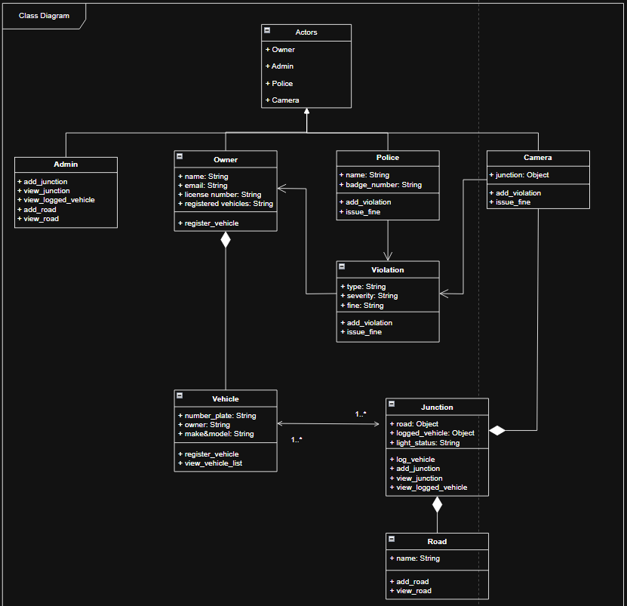
Class Diagram

Slide 4
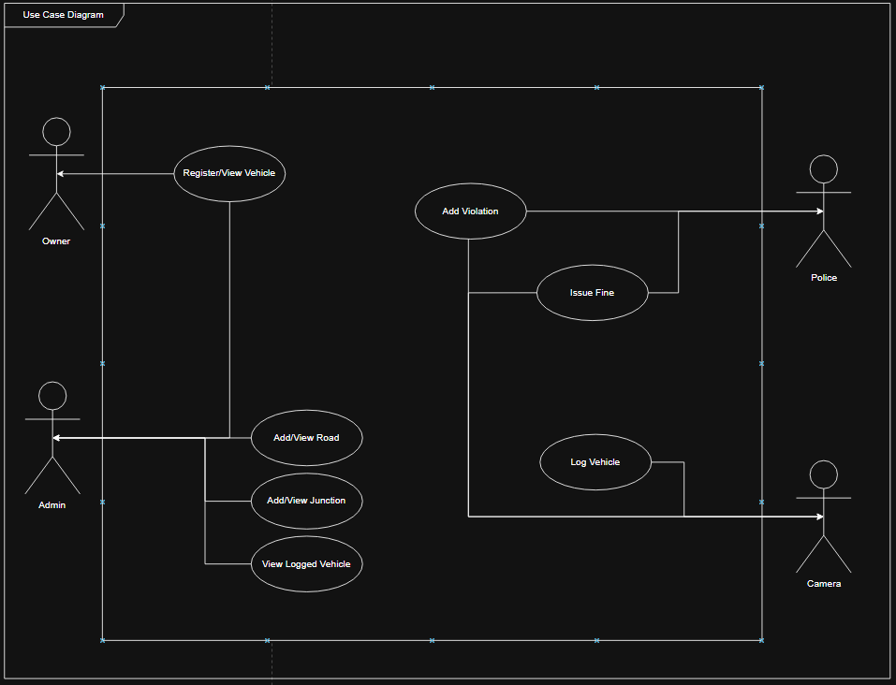
Use Case Diagram

Slide 5
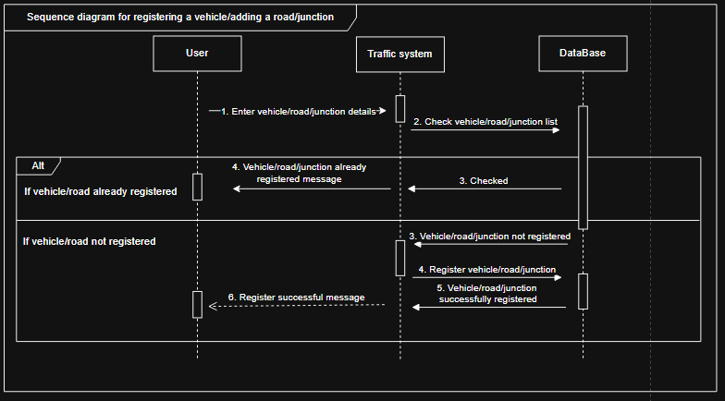
Sequence Diagram registering and adding vehicles/roads/junctions

Slide 6
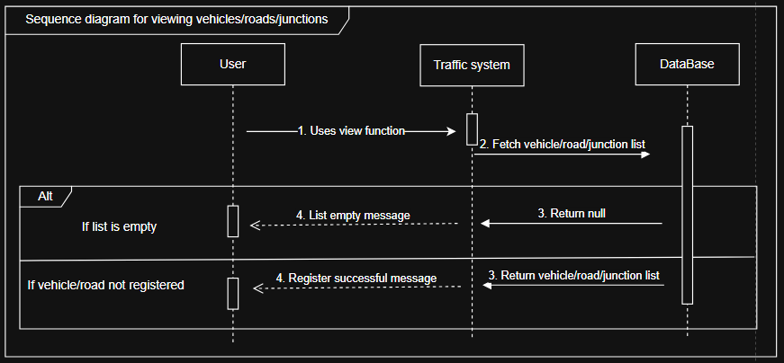
Sequence Diagram for viewing list of vehicle/road/junction

Slide 7
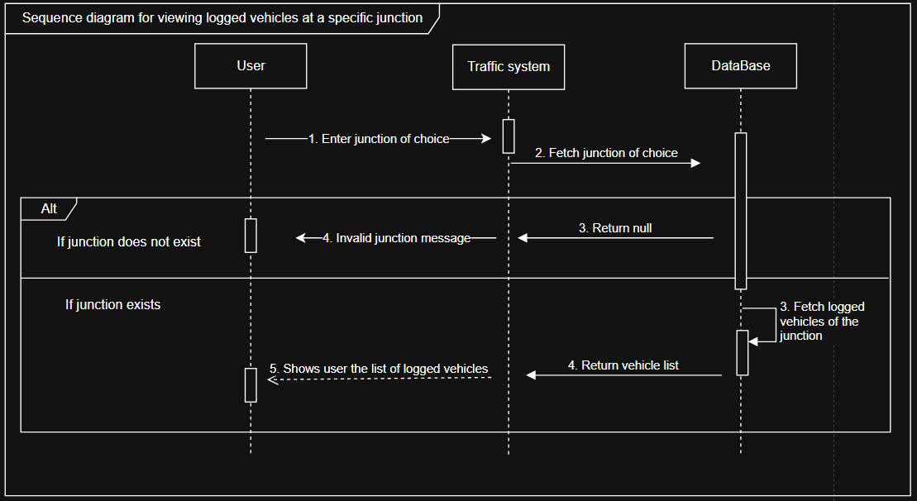
Sequence Diagram for viewing logged vehicles at a specific junctions

Slide 8
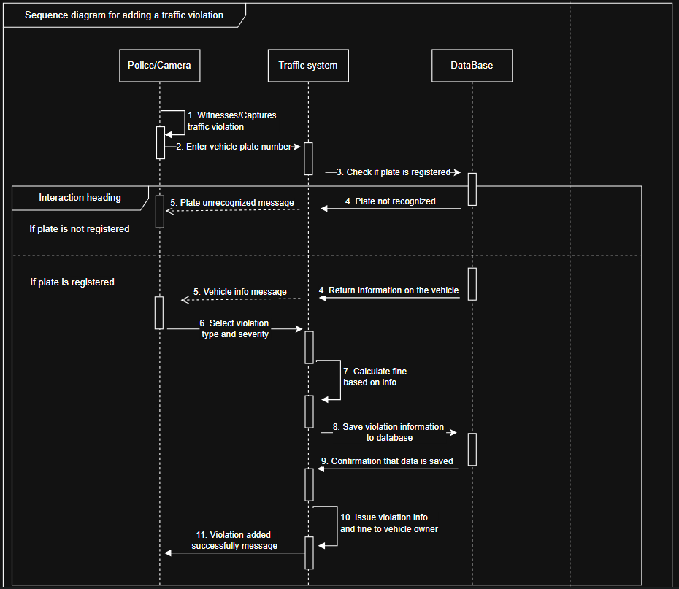
Sequence diagram for issuing traffic violations and fines

